Slide 1
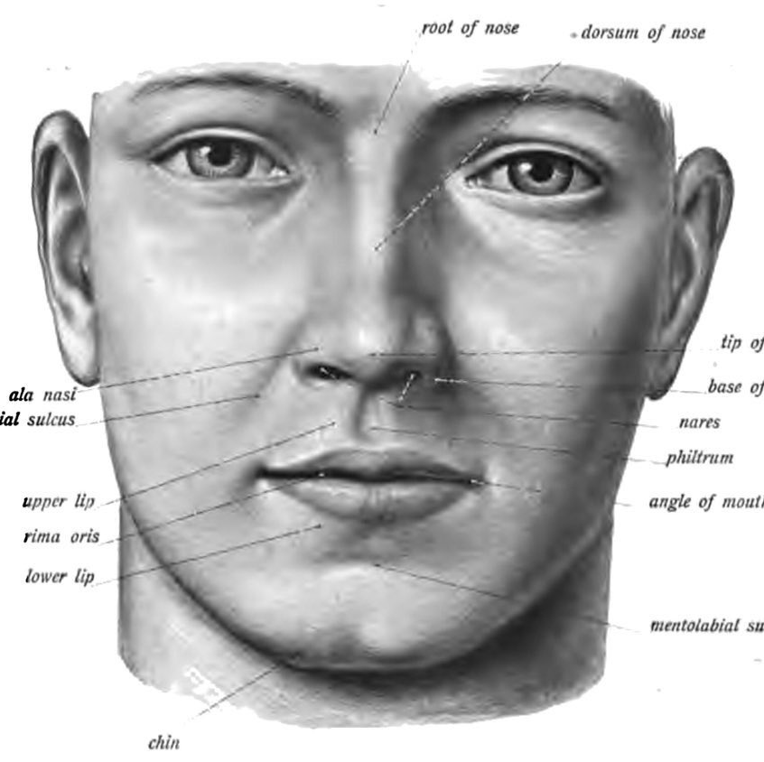
Measuring Faces

Slide 2
Measuring Faces
Scientists think facial features are affected lots of things:
What our parents look like
If we have enough food while growing up
If we get very sick while growing up
Some scientists also think that our judgments about people are related to different face features

Slide 3
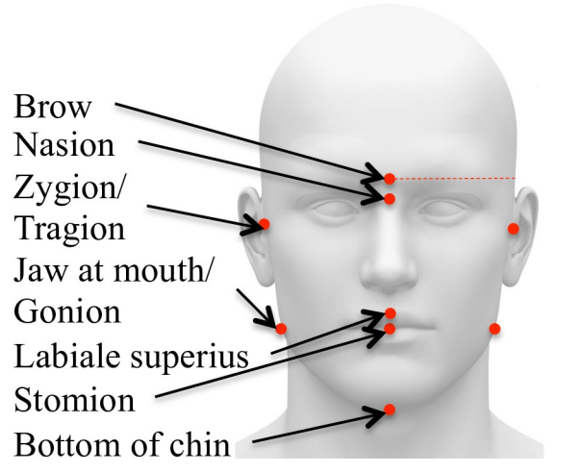
Measuring Faces Exercise
We will measure the following face features using pictures:
Eye Distance
Face Width
Face Height
Face Width-to-Height Ratio
We will also make some guesses about what the pictured persons are like
Some fancy terms to make you sound smart! Don’t worry we won’t use them :)

Slide 4
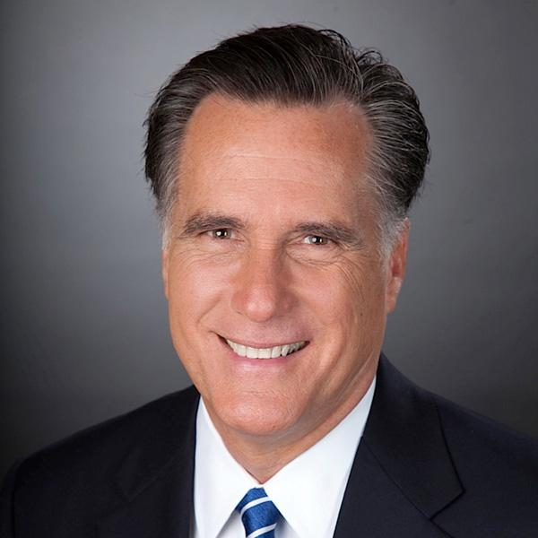
Your Materials
Picture Label and Group Code:
Picture Label = First Two Letters
Group Code = Letter after the _
MR_R
MR_R
Pictures to Measure and Guess About
A Ruler to Measure the Face Features
A Worksheet to Record your Measurements

Slide 5
Eye Distance
MR_R
MR_R
2.5 CM

Slide 6
Face Width
MR_R
MR_R
5.6 CM

Slide 7
Face Height
MR_R
MR_R
5.3 CM

Slide 8
Friendliness and Leaderlyness
For each face, record a number from 1 to 5 about how much you think they are:
Friendly
A good leader
1=not at all, 5=a lot

Slide 9
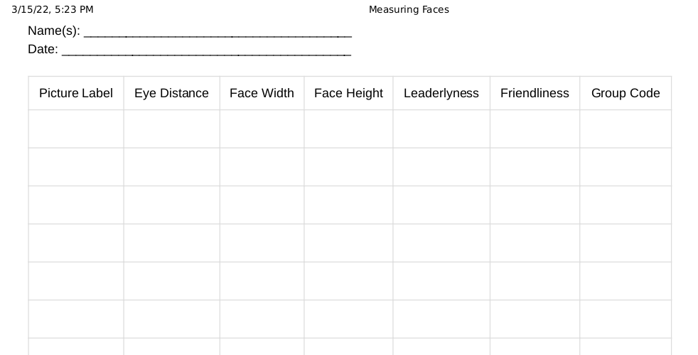
For each face, fill out the data sheet

Slide 10
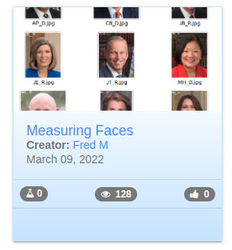
Go to iSENSE and upload
isenseproject.org
and click on this tile:

Slide 11
Now let’s look at the data!
Face measurements and ideas about being friendly or being a leader?
What about group code?

